Slide 1


Nova Bank Credit Risk Analytics
Optimizing Lending Reliability for 32,581 Customers
STRATEGIC PORTFOLIO ANALYSIS

Slide 2

THE STRATEGIC DILEMMA
Excessive Strictness
Excessive Leniency
A "too strict" policy results in the exclusion of potentially creditworthy customers, leading to missed revenue opportunities and stagnation in a competitive market.
Approving too many high-risk loans triggers significant financial losses. Nova Bank currently faces a 21.8% default rate with $77.15M in estimated losses.
Finding the "Goldilocks Zone" between risk management and fair lending.

Slide 3
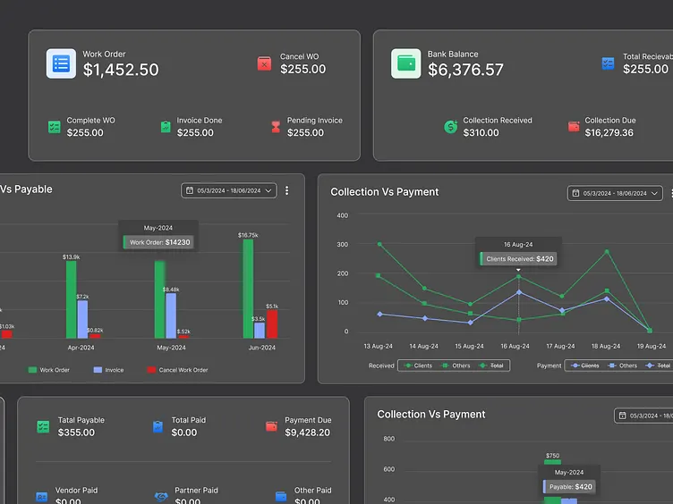

SCALE & TECHNICAL SCOPE
32k+
CUSTOMER RECORDS
28
RISK FEATURES
KEY FEATURE CATEGORIES
• Demographics: Age, Income, Home Ownership
• Financials: DTI, Credit History, Past Defaults
• Loan Details: Amount, Grade, Interest Rate, Intent

Slide 4






END-TO-END ANALYTICAL PIPELINE
Python EDA
SQL Deep Dive
Tableau BI
Conducted Univariate & Multivariate analysis. Addressed missing values using median imputation by Loan Grade.
Connected Python to SQL Server for structured analysis of default rates across demographics and loan intents.
Developed executive dashboards to visualize $306M in disbursed loans and identify high-risk segments.

Slide 5
RISK BY LOAN INTENT
Loan Intent | Default Rate (%) | Risk Assessment
Debt Consolidation | 28.38% | Critical Risk
Medical Expenses | 26.54% | High Risk
Home Improvement | 25.56% | High Risk
Personal Use | 19.49% | Moderate
Venture | 14.66% | Low Risk
Insight: Venture and Education loans show significantly higher reliability compared to Debt Consolidation.

Slide 6



THE HOMEOWNER ADVANTAGE
Home ownership is the strongest predictor of repayment stability. Renters pose the highest risk profile across all job categories.
7.47%
31.6%
OWNER DEFAULT
RENTER DEFAULT

Slide 7
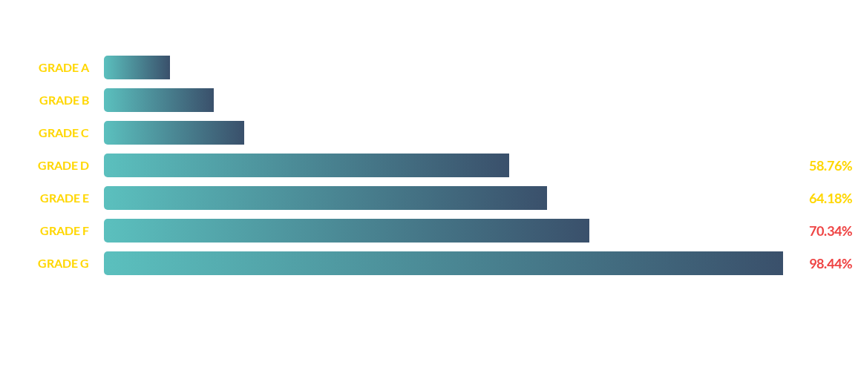
DEFAULT RATE BY LOAN GRADE
Risk escalates sharply beyond Grade C. Grades D-G represent catastrophic default probabilities.

Slide 8
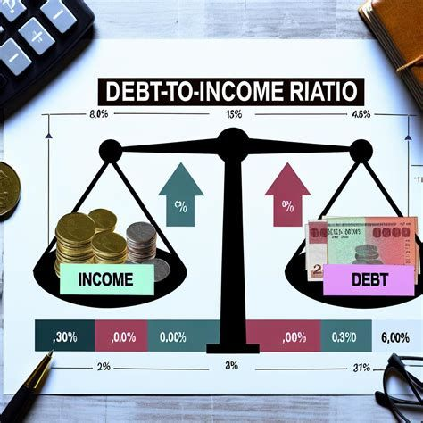

THE DTI & INTEREST RISK "TOXIC MIX"
High interest rates combined with high Debt-to-Income (DTI) ratios create an environment where repayment becomes nearly impossible.
RISK MATRIX FINDINGS:
• High DTI + High Int: 79.89% Default
• Low DTI + Low Int: 3.54% Default
• Conclusion: Instead of raising rates for high-risk customers, Nova Bank should consider outright refusal.

Slide 9
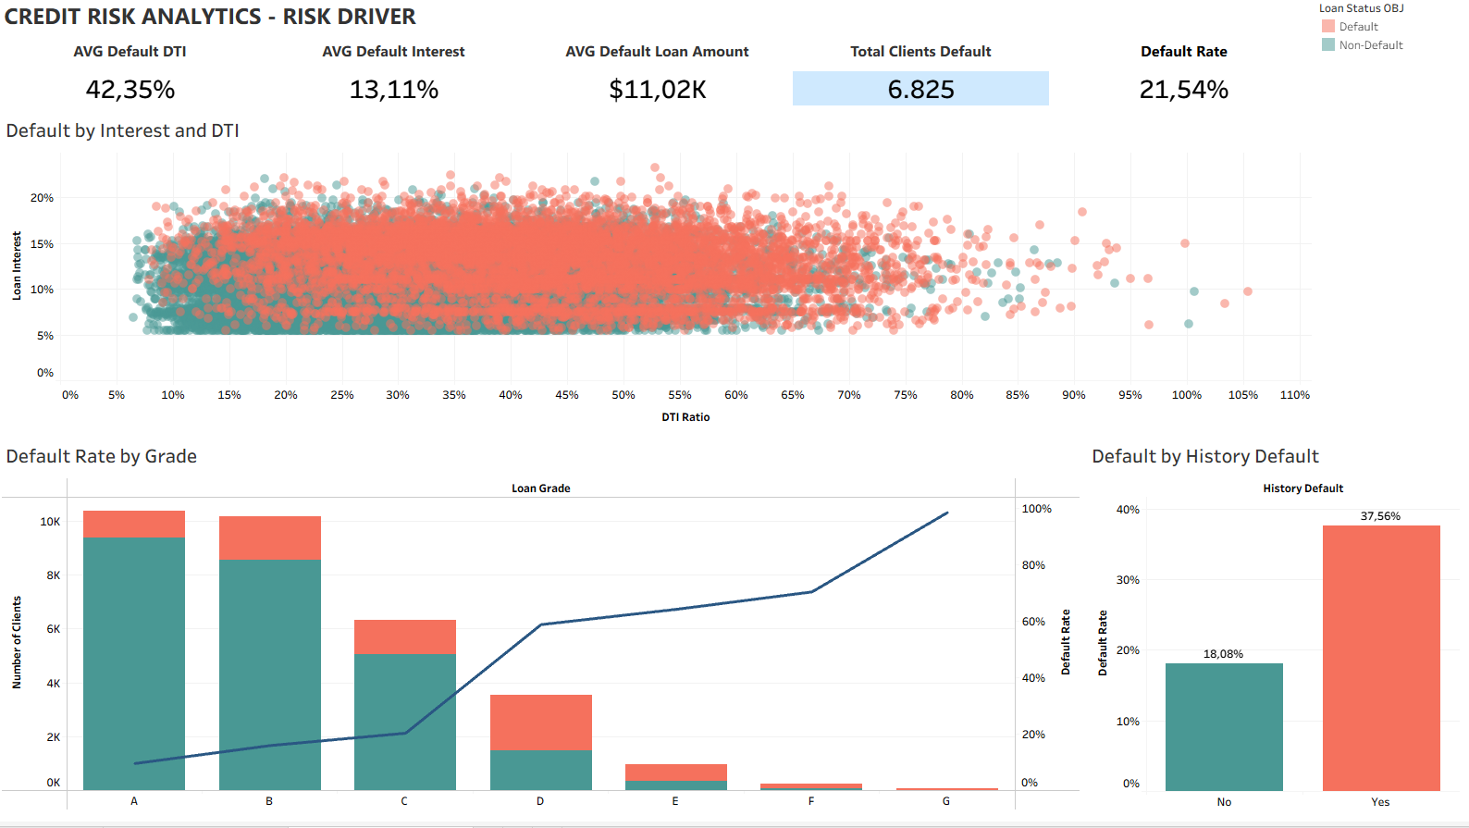


TABLEAU DASHBOARD: PORTFOLIO KPIS
TOTAL LOANS
$306.02M
DEFAULT RATE
21.54%
AVG INT RATE
11.04%

Slide 10

HISTORICAL & GEOGRAPHIC TRENDS
Past Default Behavior
Regional Consistency
Borrowers with "Default History = Yes" show a 37.56% risk compared to 18% for first-timers. Even "Safe" grade customers increase risk if they have a prior default on file.
Default rates are remarkably stable across the three core markets:
• Canada: 21.61%
• USA: 21.57%
• UK: 21.46%

Slide 11
STRATEGIC ACTION PLAN
Risk-Based Tiering: Implement stricter policies for Grades D to G, including co-signers or collateral requirements.
Incentivize Stability: Prioritize applicants with home ownership and full-time employment through dynamic interest rate discounts.
DTI Hard Caps: Instead of raising interest rates for high-DTI borrowers, enforce hard refusal thresholds to avoid the "debt trap" default.
Purpose-Specific Clauses: Add minimum requirements or restricted terms for Debt Consolidation and Medical loans.

Slide 12
Questions?
Nova Bank: Customer Credit Risk Analytics

